Slide 1

09 March 2021

Slide 2
Agenda
Class reps
Two-dimensional Arrays
Two-dimensional Array processing
Introduction to Linked Lists
Conclusion

Slide 3
Two-dimensional Arrays
information is organized in a table or grid
Elements are accessed by referring to rows and columns in the table.
Can be thought of as an array of arrays

Slide 4
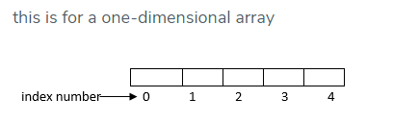
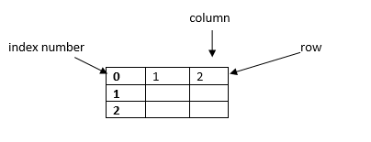
comparison
Two-dimensional array

Slide 5
Two-dimensional Arrays
We use two indexes to refer to a value in a two-dimensional array, one specifying the row and another the column.
How to declare in Java:
double [ ] [ ] multiArr = new double [m] [n];
where m refers to number of rows,
and n the number of columns

Slide 6
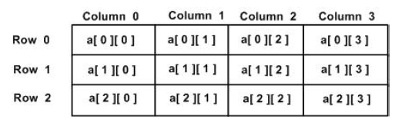
Two-dimensional Arrays
double [ ] [ ] a = new double [3] [4];

Slide 7
Two-dimensional Arrays
a [1][2] = 8;
8

Slide 8
Class exercise 1
Display all elements of the array
int[ ][ ] myArr = { {9,2,7}, {8,5,3} };
for (int row = 0; row < 2; row ++)
{
for (int col = 0; col < 3; col ++)
{
System.out.print(myArr[row][col] + " ");
}
System.out.println();
}

Slide 9
Class exercise 1
Display all elements of the array
int[ ][ ] myArr = { {9,2,7}, {8,5,3} };
for (int row = 0; row < 2; row ++)
{
for (int col = 0; col < 3; col ++)
{
System.out.print(myArr[row][col] + " ");
}
System.out.println();
}
col 0
col 1
col 2
row 0
9 | 2 | 7
8 | 5 | 3
row 1

Slide 10
Class exercise 1
Display all elements of the array
int[ ][ ] myArr = { {9,2,7}, {8,5,3} };
for (int row = 0; row < 2; row ++)
{
for (int col = 0; col < 3; col ++)
{
System.out.print(myArr[row][col] + " ");
}
System.out.println();
}
outer loop iteration | Inner loop iteration | row | col
1 |  | 0
 | 1 |  | 0
col 0
col 1
col 2
row 0
9 | 2 | 7
8 | 5 | 3
row 1

Slide 11
Class exercise 1
Display all elements of the array
int[ ][ ] myArr = { {9,2,7}, {8,5,3} };
for (int row = 0; row < 2; row ++)
{
for (int col = 0; col < 3; col ++)
{
System.out.print(myArr[row][col] + " ");
}
System.out.println();
}
outer loop iteration | Inner loop iteration | row | col
1 |  | 0
 | 1 |  | 0
 | 2 |  | 1
col 0
col 1
col 2
row 0
9 | 2 | 7
8 | 5 | 3
row 1

Slide 12
Class exercise 1
Display all elements of the array
int[ ][ ] myArr = { {9,2,7}, {8,5,3} };
for (int row = 0; row < 2; row ++)
{
for (int col = 0; col < 3; col ++)
{
System.out.print(myArr[row][col] + " ");
}
System.out.println();
}
outer loop iteration | Inner loop iteration | row | col
1 |  | 0
 | 1 |  | 0
 | 2 |  | 1
 | 3 |  | 2
col 0
col 1
col 2
row 0
9 | 2 | 7
8 | 5 | 3
row 1

Slide 13
Class exercise 1
Display all elements of the array
int[ ][ ] myArr = { {9,2,7}, {8,5,3} };
for (int row = 0; row < 2; row ++)
{
for (int col = 0; col < 3; col ++)
{
System.out.print(myArr[row][col] + " ");
}
System.out.println();
}
outer loop iteration | Inner loop iteration | row | col
1 |  | 0
 | 1 |  | 0
 | 2 |  | 1
 | 3 |  | 2
2 |  | 1
 | 1 |  | 0
col 0
col 1
col 2
row 0
9 | 2 | 7
8 | 5 | 3
row 1

Slide 14
Class exercise 1
Display all elements of the array
int[ ][ ] myArr = { {9,2,7}, {8,5,3} };
for (int row = 0; row < 2; row ++)
{
for (int col = 0; col < 3; col ++)
{
System.out.print(myArr[row][col] + " ");
}
System.out.println();
}
outer loop iteration | Inner loop iteration | row | col
1 |  | 0
 | 1 |  | 0
 | 2 |  | 1
 | 3 |  | 2
2 |  | 1
 | 1 |  | 0
 | 2 |  | 1
col 0
col 1
col 2
row 0
9 | 2 | 7
8 | 5 | 3
row 1

Slide 15
Class exercise 1
Display all elements of the array
int[ ][ ] myArr = { {9,2,7}, {8,5,3} };
for (int row = 0; row < 2; row ++)
{
for (int col = 0; col < 3; col ++)
{
System.out.print(myArr[row][col] + " ");
}
System.out.println();
}
outer loop iteration | Inner loop iteration | row | col
1 |  | 0
 | 1 |  | 0
 | 2 |  | 1
 | 3 |  | 2
2 |  | 1
 | 1 |  | 0
 | 2 |  | 1
 | 3 |  | 2
col 0
col 1
col 2
row 0
9 | 2 | 7
8 | 5 | 3
row 1

Slide 16
Class exercise 2
Display all elements of the array
int[ ][ ] myArr = { {9,2,7}, {8,5,3} };
{
{
System.out.print(myArr[row][col] + " ");
}
System.out.println();
}
outer loop iteration | Inner loop iteration | row | col
for (int col = 0; col < 3; col ++)
for (int row = 0; row < 2; row ++)
col 0
col 1
col 2
row 0
9 | 2 | 7
8 | 5 | 3
row 1

Slide 17
Class exercise 2
Display all elements of the array
int[ ][ ] myArr = { {9,2,7}, {8,5,3} };
{
{
System.out.print(myArr[row][col] + " ");
}
System.out.println();
}
outer loop iteration | Inner loop iteration | row | col
1 |  |  | 0
 | 1 | 0
for (int col = 0; col < 3; col ++)
for (int row = 0; row < 2; row ++)
col 0
col 1
col 2
row 0
9 | 2 | 7
8 | 5 | 3
row 1

Slide 18
Class exercise 2
Display all elements of the array
int[ ][ ] myArr = { {9,2,7}, {8,5,3} };
{
{
System.out.print(myArr[row][col] + " ");
}
System.out.println();
}
outer loop iteration | Inner loop iteration | row | col
1 |  |  | 0
 | 1 | 0
 | 2 | 1
for (int col = 0; col < 3; col ++)
for (int row = 0; row < 2; row ++)
col 0
col 1
col 2
row 0
9 | 2 | 7
8 | 5 | 3
row 1

Slide 19
Class exercise 2
Display all elements of the array
int[ ][ ] myArr = { {9,2,7}, {8,5,3} };
{
{
System.out.print(myArr[row][col] + " ");
}
System.out.println();
}
outer loop iteration | Inner loop iteration | row | col
1 |  |  | 0
 | 1 | 0
 | 2 | 1
2 |  |  | 1
 | 1 | 0
for (int col = 0; col < 3; col ++)
for (int row = 0; row < 2; row ++)
col 0
col 1
col 2
row 0
9 | 2 | 7
8 | 5 | 3
row 1

Slide 20
Class exercise 2
Display all elements of the array
int[ ][ ] myArr = { {9,2,7}, {8,5,3} };
{
{
System.out.print(myArr[row][col] + " ");
}
System.out.println();
}
outer loop iteration | Inner loop iteration | row | col
1 |  |  | 0
 | 1 | 0
 | 2 | 1
2 |  |  | 1
 | 1 | 0
 | 2 | 1
for (int col = 0; col < 3; col ++)
for (int row = 0; row < 2; row ++)
col 0
col 1
col 2
row 0
9 | 2 | 7
8 | 5 | 3
row 1

Slide 21
Class exercise 2
Display all elements of the array
int[ ][ ] myArr = { {9,2,7}, {8,5,3} };
{
{
System.out.print(myArr[row][col] + " ");
}
System.out.println();
}
outer loop iteration | Inner loop iteration | row | col
1 |  |  | 0
 | 1 | 0
 | 2 | 1
2 |  |  | 1
 | 1 | 0
 | 2 | 1
3 |  |  | 2
 | 1 | 0
for (int col = 0; col < 3; col ++)
for (int row = 0; row < 2; row ++)
col 0
col 1
col 2
row 0
9 | 2 | 7
8 | 5 | 3
row 1

Slide 22
Class exercise 2
Display all elements of the array
int[ ][ ] myArr = { {9,2,7}, {8,5,3} };
{
{
System.out.print(myArr[row][col] + " ");
}
System.out.println();
}
outer loop iteration | Inner loop iteration | row | col
1 |  |  | 0
 | 1 | 0
 | 2 | 1
2 |  |  | 1
 | 1 | 0
 | 2 | 1
3 |  |  | 2
 | 1 | 0
 | 2 | 1
for (int col = 0; col < 3; col ++)
for (int row = 0; row < 2; row ++)
col 0
col 1
col 2
row 0
9 | 2 | 7
8 | 5 | 3
row 1

Slide 23
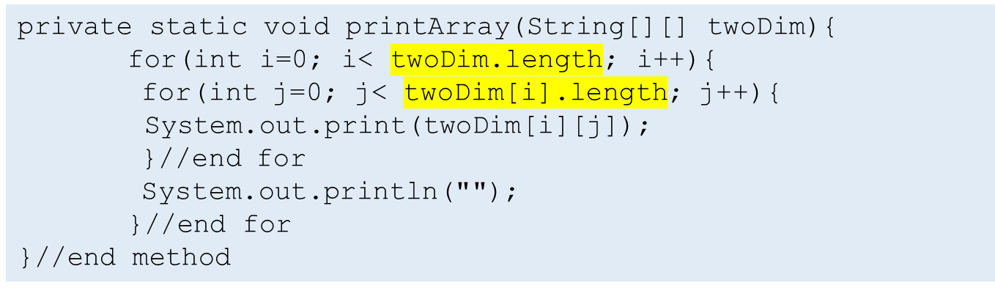
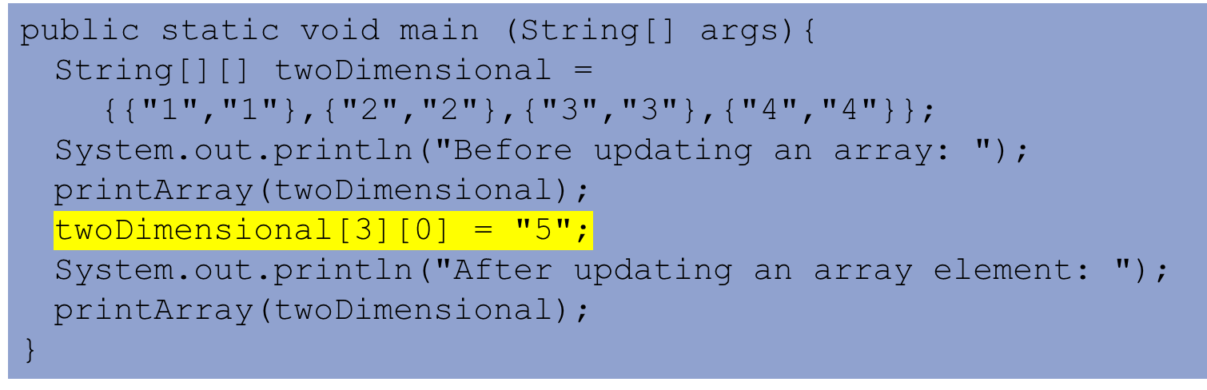
Update an element of 2D Array
Class exercise 3: Explain what this Java code segment does. What is the output?
Prints all the elements of the array

Slide 24
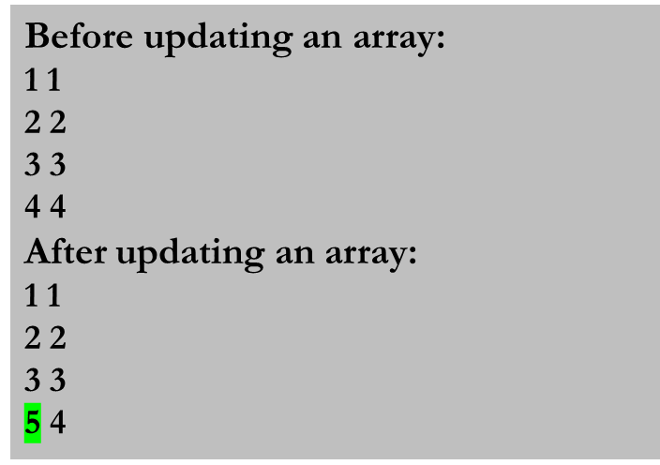
Update an element of 2D Array
Class exercise 3: output
String[][] twoDimensional = {{"1","1"},{"2","2"},{"3","3"},{"4","4"}};
System.out.println("Before updating an array: ");
printArray(twoDimensional);
twoDimensional[3][0] = "5";
System.out.println("After updating an array element: ");
printArray(twoDimensional);
2 cols
1 1
2 2
3 3
4 4
4 rows

Slide 25
Remove an element from 2D Array
It’s a tricky situation to try to delete an item in 2d arrays.
2-dimensional array is nothing but an array of arrays.
We could remove that element by replacing/shifting the other elements into other places.
This is a very inefficient/clumsy way to achieve the goal.

Slide 26
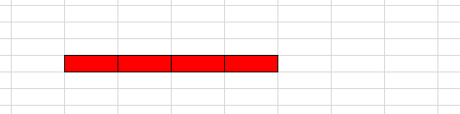
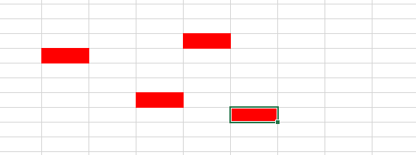
Next : Linked lists
Array
Linked List

